Slide 1
Lecture 12 Graphs
Department of Computer Science
Hofstra University
Acknowledgement: Lecture slides based on UofW Course on Data Structures

Slide 2
Inter-data Relationships
Arrays
Trees
Graphs
Elements only store pure data, no connection info
Only relationship between data is order
Elements store data and connection info
Directional relationships between nodes; limited connections
Elements AND connections can store data
Relationships dictate structure; huge freedom with connections
C
B
0 | 1 | 2
A | B | C
B
A
C
A

Slide 3
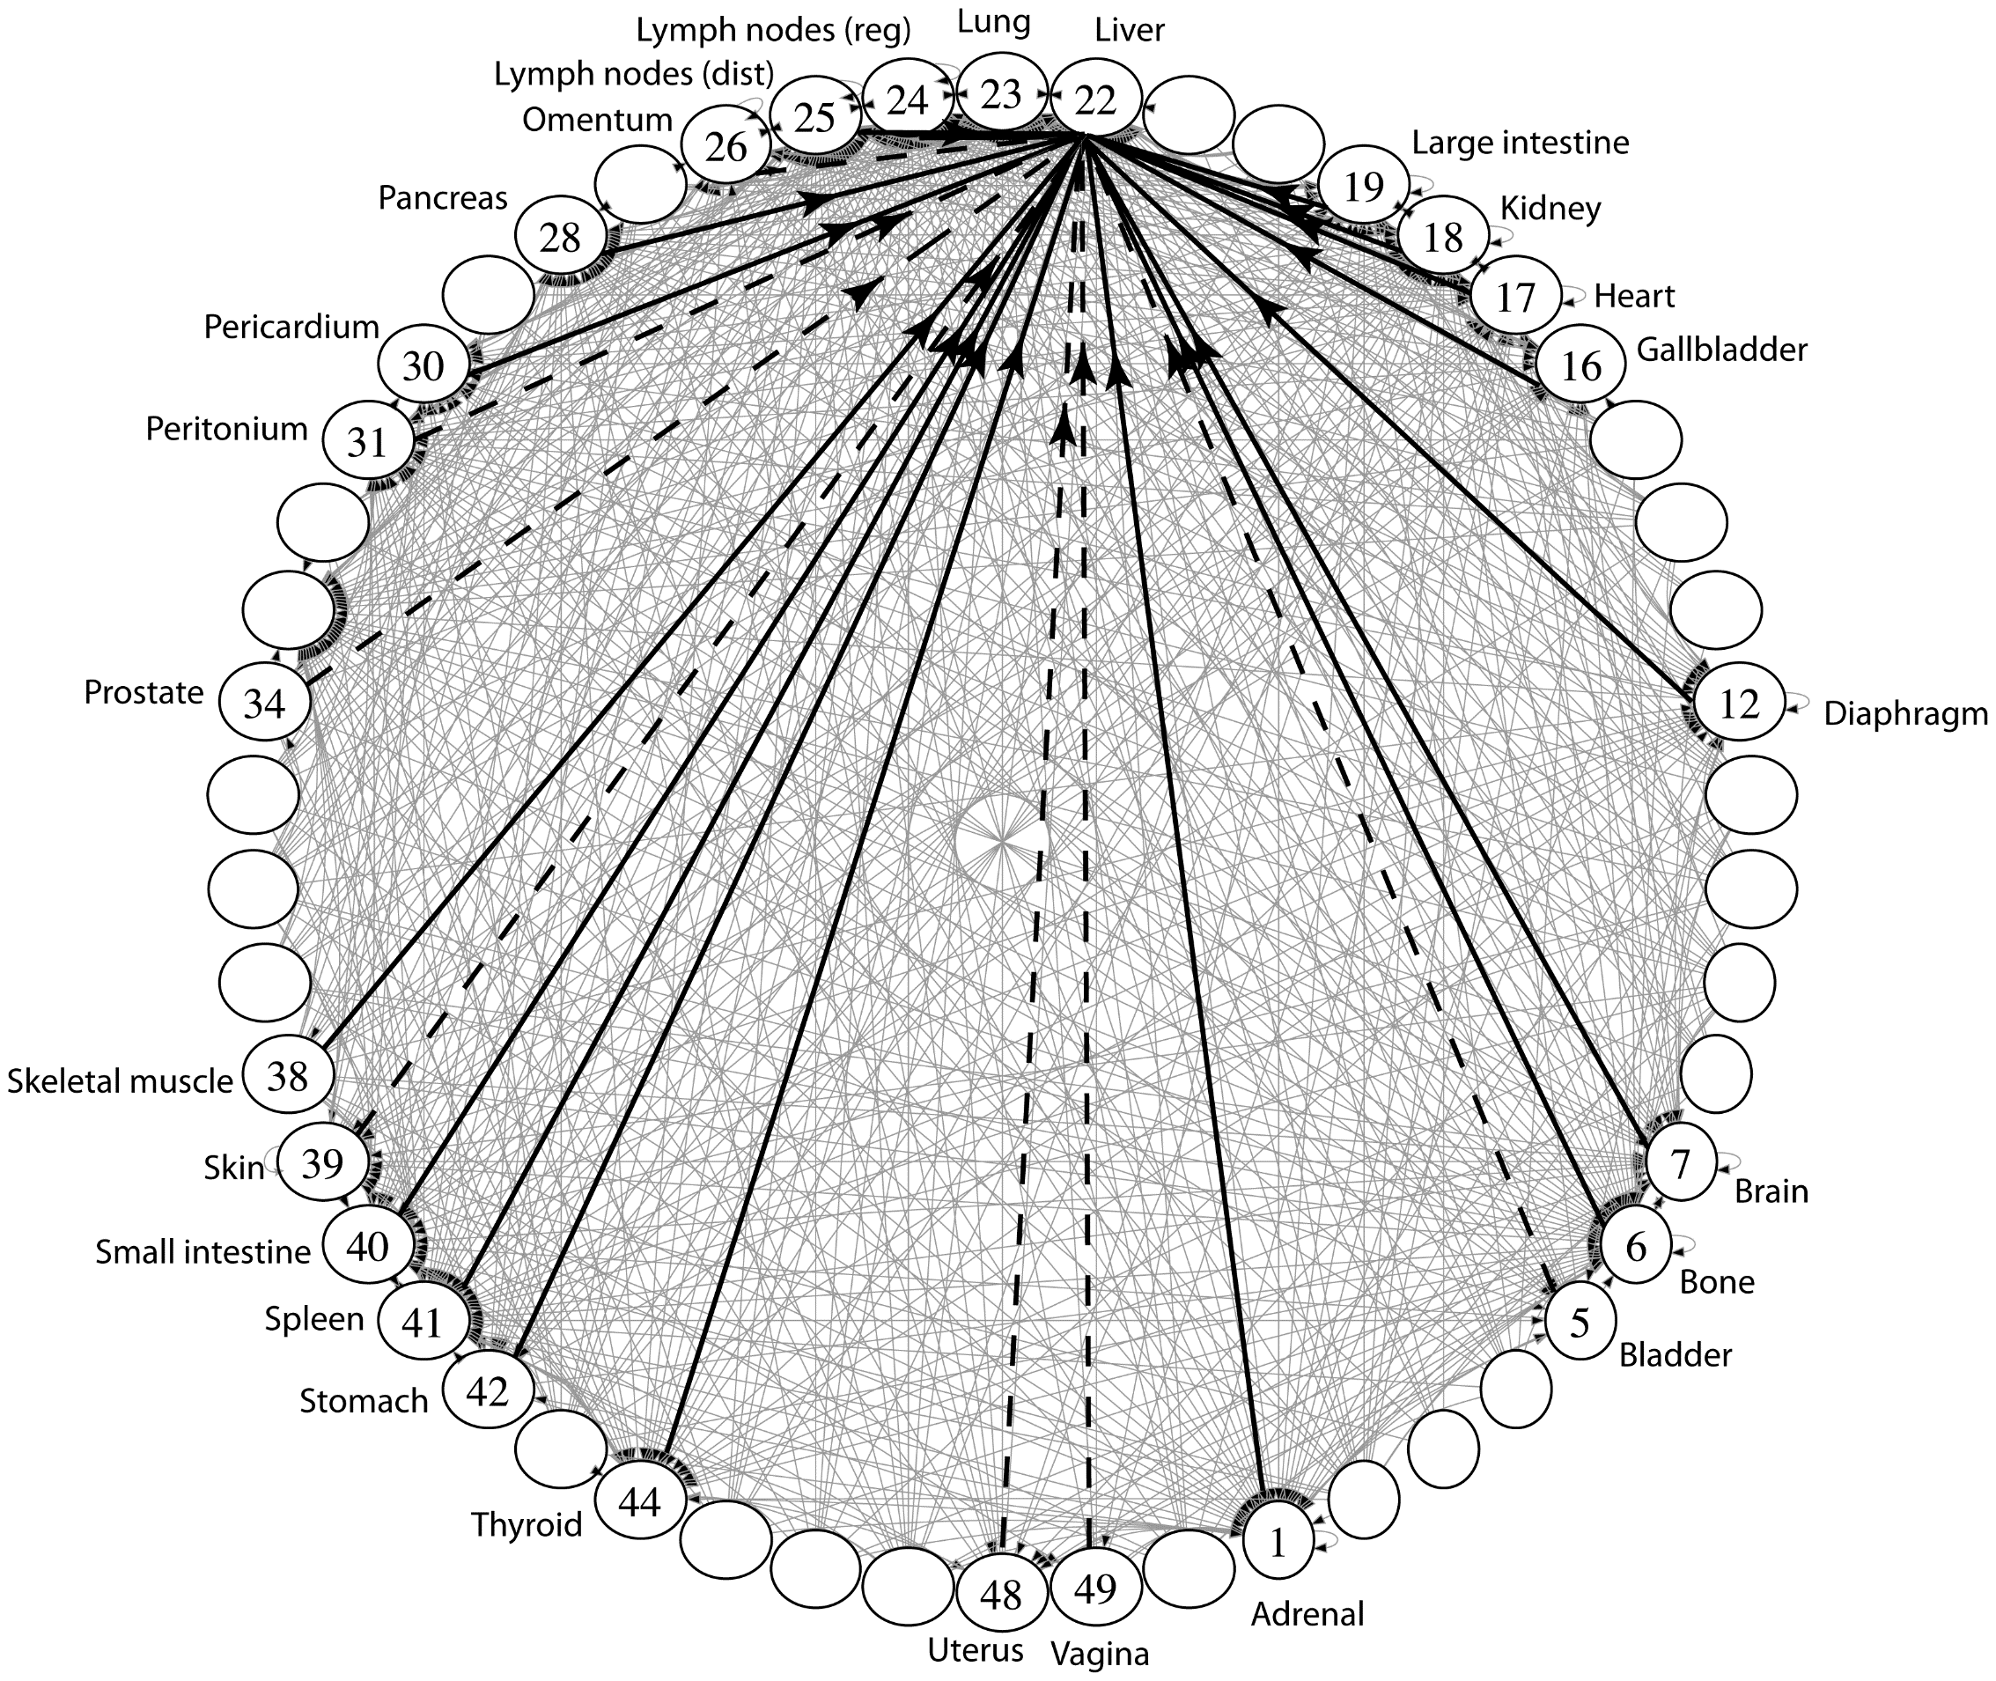
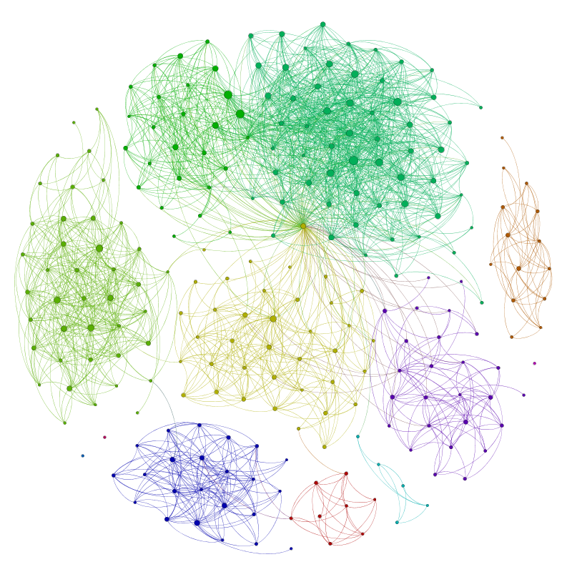
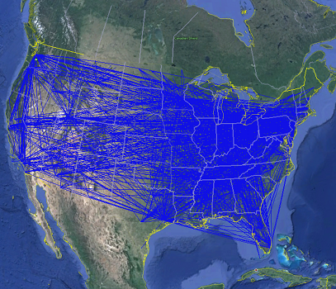
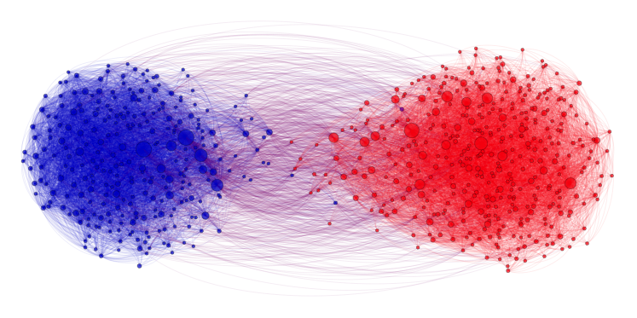
Applications
Physical Maps
Airline maps
nodes are airports, edges are flight paths
Traffic
nodes are addresses, edges are streets
Relationships
Social media graphs
nodes are accounts, edges are follower relationships
Traffic
nodes are classes, edges are usage
Influence
Biology
nodes are cancer cell desinations, edges are migration paths
Related topics
Web Page Ranking
nodes are web pages, edges are hyperlinks
Wikipedia
nodes are articles, edges are links
And so many more!!
www.allthingsgraphed.com

Slide 4
Graph: Formal Definition
G
A graph is defined by a pair of sets G = (V, E) where…
V is a set of nodes
A node or “node” is a data entity
V = { A, B, C, D, E, F, G, H }
E is a set of edges
An edge is a connection between two nodes
E = { (A, B), (A, C), (A, D), (A, H),
(C, B), (B, D), (D, E), (D, F),
(F, G), (G, H)}
H
F
A
D
C
B
E

Slide 5
Graph Terminology
Undirected Graph:
Graph Direction
Undirected graph – edges have no direction and are two-way
V = { Karen, Jim, Pam }
E = { (Jim, Pam), (Jim, Karen) } inferred (Karen, Jim) and (Pam, Jim)
Directed graphs – edges have direction and are thus one-way
V = { Gunther, Rachel, Ross }
E = { (Gunther, Rachel), (Rachel, Ross), (Ross, Rachel) }
Degree of a Node
Degree – the number of edges connected to that node
Karen : 1, Jim : 2, Pam : 1
In-degree – the number of directed edges that point to a node
Gunther : 0, Rachel : 2, Ross : 1
Out-degree – the number of directed edges that start at a node
Gunther : 1, Rachel : 1, Ross : 1
Karen
Jim
Directed Graph:
Pam
Rachel
Gunther
Ross

Slide 6
More Graph Terminology
j
f
g
Two nodes are connected if there is a path between them
If all the nodes are connected, we say the graph is connected
A directed graph is weakly connected if replacing every directed edge with an undirected edge results in a connected graph
A directed graph is strongly connected if a directed path exists between every pair of nodes
The number of edges leaving a node is its degree
A path is a sequence of nodes connected by edges
A simple path is a path without repeated nodes
A cycle is a path whose first and last nodes are the same
A graph with a cycle is cyclic
e
not connected
d
b
c
a
i
p
n
connected
o
m
i
p
n
o
m

Slide 7
Directed vs Undirected; Acyclic vs Cyclic
Directed:
Undirected:
b
b
e
Acyclic:
a
d
a
d
c
c
b
b
Cyclic:
a
d
a
d
c
c

Slide 8
Labeled and Weighted Graphs
Node Labels
Node & Edge Labels
Edge Labels
b
e
c
2
c
5
a
d
a
d
a
d
1
3
b
b
c
4
Numeric Edge Labels (Edge Weights)
3
1
1
2

Slide 9
Multi-Variable Analysis
So far, we thought of everything as being in terms of some single argument “n”
With graphs, we need to consider:
n (or |V|): total number of nodes (sometimes written as V)
m (or |E|): total number of edges (sometimes written as E)
deg(u): degree of node u (how many outgoing edges it has)

Slide 10
Adjacency Matrix
4
0
1
5
6
In an adjacency matrix a[u][v] is 1 if there is an edge (u,v), and 0 otherwise.
Worst-case Time Complexity (|V| = n, |E| = m):
Add Edge:
Remove Edge:
Check edge exists from (u,v):
Get out-neighbors of u:
Get in-neighbors of u:
Space Complexity:
More suitable for dense graphs
2
3
 | 0 | 1 | 2 | 3 | 4 | 5 | 6
0 | 0 | 1 | 1 | 0 | 0 | 0 | 0
1 | 1 | 0 | 0 | 1 | 0 | 0 | 0
2 | 1 | 0 | 0 | 1 | 0 | 0 | 0
3 | 0 | 1 | 1 | 0 | 0 | 1 | 0
4 | 0 | 0 | 0 | 0 | 0 | 1 | 0
5 | 0 | 0 | 0 | 1 | 1 | 0 | 0
6 | 0 | 0 | 0 | 0 | 0 | 0 | 0
O(1)
O(1)
O(1)
O(n)
O(n)
O(n²)
For an undirected graph, adjacency matrix is symmetric w.r.t diagonal line. A node u’s out-neighbors are the same as its in-neighbors
Notes:
It is usual to write |V| = n and |E| = m, though sometimes we’ll abuse notation and just use V and E.
Adjacency Matrices take more space, why would you use them?
For dense graphs (where m is close to n²), the running times will be close
And the constant factors can be much better for matrices than for lists

Slide 11
Adjacency List
B
A
In an adjacency matrix a[u][v] is 1 if there is an edge (u,v), and 0 otherwise.
Worst-case Time Complexity (|V| = n, |E| = m):
Add Edge:
Remove Edge:
Check edge exists from (u,v):
Get outneighbors of u:
Get inneighbors of u:
Space Complexity:
More suitable for sparse graphs
C
D
Linked Lists
0
1
2
3
O(1)
A
B
C
O(deg(u))
B
O(deg (u))
O(deg(u))
C
B
D
O(n + m)
O(n + m)
D
A

Slide 12
Adjacency List
B
In an adjacency matrix a[u][v] is 1 if there is an edge (u,v), and 0 otherwise.
Worst-case Time Complexity (assuming a good hash function so all hash table operations are O(1)) (|V| = n, |E| = m):
Add Edge:
Remove Edge:
Check edge exists from (u,v):
Get outneighbors of u:
Get inneighbors of u:
Space Complexity:
A
C
D
Hash Tables
0 | 1 | 2 | 3 | 4
0
1
2
3
O(1)
A
B
C
O(1)
B
O(1)
0 | 1 | 2 | 3 | 4
O(deg(u) )
C
B
D
O(n)
0 | 1 | 2 | 3 | 4
D
A
O(n + m)
Notes:
For this class, unless we say otherwise, we’ll assume the hash tables operations on graphs are all O(1)
Because you can probably control the keys
Unless we say otherwise, assume we’re using the hash table approach

Slide 13
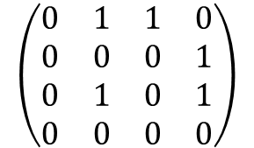
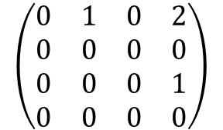
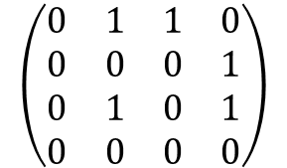
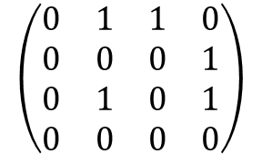
2-Hop Neighbors (through Matrix Multiplication)
Matrix multiplication for finding two-hop neighbors
Node 3 is a two-hop neighbor of node 0 along two different paths
 | 0 | 1 | 2 | 3
0 | 0 | 1 | 1 | 0
1 | 0 | 0 | 0 | 1
2 | 0 | 1 | 0 | 1
3 | 0 | 0 | 0 | 0
 | 0 | 1 | 2 | 3
0 | 0 | 1 | 0 | 2
1 | 0 | 0 | 0 | 0
2 | 0 | 0 | 0 | 1
3 | 0 | 0 | 0 | 0
0
1
Node 3 is a two-hop neighbor of node 2 along 1 path
2
3
A graph and its adjacency matrix representation
The adjacency matrix representation
The adjacency matrix representation for two-hop neighbors, obtained by matrix-matrix product of the adjacency matrix
2
$$\left(\begin{matrix}0 & 1 & 1 & 0 \\ 0 & 0 & 0 & 1 \\ 0 & 1 & 0 & 1 \\ 0 & 0 & 0 & 0\end{matrix}\right)$$
$$\left(\begin{matrix}0 & 1 & 1 & 0 \\ 0 & 0 & 0 & 1 \\ 0 & 1 & 0 & 1 \\ 0 & 0 & 0 & 0\end{matrix}\right)$$
$$\left(\begin{matrix}0 & 1 & 1 & 0 \\ 0 & 0 & 0 & 1 \\ 0 & 1 & 0 & 1 \\ 0 & 0 & 0 & 0\end{matrix}\right)$$
$$\left(\begin{matrix}0 & 1 & 0 & 2 \\ 0 & 0 & 0 & 0 \\ 0 & 0 & 0 & 1 \\ 0 & 0 & 0 & 0\end{matrix}\right)$$
=
=
Notes:
Matrix multiplication is well studied and optimized in software and hardware, and can be done very fast
For all the nodes in the graph
Consider the multiplication of the first row of the left matrix wit the last column of the right matrix:
0*0 + 1*1 + 1*1 + 0*0 = 2.
This means that there are two 2-hop paths from 1 to 3:
Path 0→1→ 3 consisting of two edges 0→1 & 1→ 3, corresponding to the first term of 1*1
Path 0→2→ 3 consisting of two edges 0→2 &2→ 3, corresponding to the second term of 1*1

Slide 14
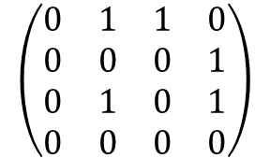
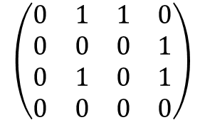
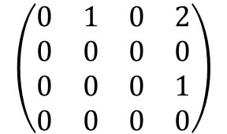
2-Hop Neighbors (through Matrix Multiplication)
Consider the multiplication of the first row of the left matrix wit the last column of the right matrix:
0*0 + 1*1 + 1*1 + 0*0 = 2.
This means that there are two 2-hop paths from 1 to 3:
Path 0→1→ 3 consisting of two edges 0→1 & 1→ 3, corresponding to the first term of 1*1
Path 0→2→ 3 consisting of two edges 0→2 &2→ 3, corresponding to the second term of 1*1
Path 0→1→ 3
$$\left(\begin{matrix}0 & 1 & 1 & 0 \\ 0 & 0 & 0 & 1 \\ 0 & 1 & 0 & 1 \\ 0 & 0 & 0 & 0\end{matrix}\right)$$
$$\left(\begin{matrix}0 & 1 & 1 & 0 \\ 0 & 0 & 0 & 1 \\ 0 & 1 & 0 & 1 \\ 0 & 0 & 0 & 0\end{matrix}\right)$$
$$\left(\begin{matrix}0 & 1 & 0 & 2 \\ 0 & 0 & 0 & 0 \\ 0 & 0 & 0 & 1 \\ 0 & 0 & 0 & 0\end{matrix}\right)$$
0
1
=
2
3
Path 0→2→ 3

Slide 15
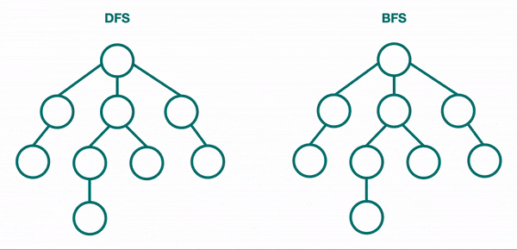
BFS & DFS for Trees

Slide 16
Breadth-First Search (BFS)
BFS: Explore nodes “layer by layer”; like level-order traversal of a tree, now generalized to any graph; visit 1-hop neighbors, then 2-hop neighbors, …, until all nodes have been visited
2
3
VISITED
4
This is our goal, but how do we translate into code?
Use a data structure to ”queue up” children…
s
1
9
7
0
2
4
1
5
for (Node n : s.neighbors) {
6
3
8
Notes:
Key observation: recursive calls interrupted s.neighbors loop to immediately process children
For BFS, instead we want to complete that loop before processing children
closer nodes first, instead of following one choice all the way to the end

Slide 17
BFS Implementation
A queue keeps track of “outer edge” of nodes still to explore
bfs(Graph graph, Node start) {
Queue<Node> perimeter = new Queue<>();
Set<Node> visited = new Set<>();
perimeter.add(start);
visited.add(start);
Kick off the algorithm by adding start to perimeter
while (!perimeter.isEmpty()) {
Node from = perimeter.remove();
3
Grab one element at a time from the perimeter
for (Edge edge : graph.edgesFrom(from)) {
Node to = edge.to();
4
Look at all that element’s unvisited children
if (!visited.contains(to)) {
perimeter.add(to);
visited.add(to);
}
}
}
}
start
1
9
7
Add new ones to perimeter!
2
5
6
8

Slide 18
BFS Implementation: In Action
PERIMETER
bfs(Graph graph, Node start) {
Queue<Node> perimeter = new Queue<>();
Set<Node> visited = new Set<>();
perimeter.add(start);
visited.add(start);
while (!perimeter.isEmpty()) {
Node from = perimeter.remove();
for (Edge edge : graph.edgesFrom(from)) {
Node to = edge.to();
if (!visited.contains(to)) {
perimeter.add(to);
visited.add(to);
}
}
}
}
1
2
4
5
3
6
8
9
7
3
VISITED
start
4
1
9
7
2
5
6
8

Slide 19
BFS Intuition: Why Does it Work?
PERIMETER
bfs(Graph graph, Node start) {
Queue<Node> perimeter = new Queue<>();
Set<Node> visited = new Set<>();
perimeter.add(start);
visited.add(start);
while (!perimeter.isEmpty()) {
Node from = perimeter.remove();
for (Edge edge : graph.edgesFrom(from)) {
Node to = edge.to();
if (!visited.contains(to)) {
perimeter.add(to);
visited.add(to);
}
}
}
}
1
2
4
5
3
6
8
9
7
2
3
VISITED
start
4
1
9
0
7
2
4
1
5
6
Using FIFO queue means we explore an entire layer before moving on to the next layer
Keep going until perimeter is empty
3
8

Slide 20
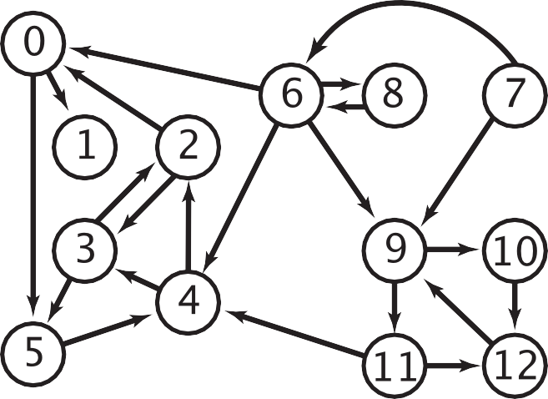



BFS Application: Multiple-Source Shortest Paths Problem
Given a digraph and a set of source nodes, find shortest path from any node in the set to every other node, assuming all edges have weight 1.
e.g., S = { 1, 7, 10 }.
Shortest path to 4 is 7 → 6 → 4.
Shortest path to 5 is 7 → 6 → 0 → 5.
Shortest path to 12 is 10 → 12.
Can be done with BFS, and initialize by enqueuing all source nodes
0
1
6
5
8
7
9
2
4
10
12
3
11
dist = 0
dist = 1
(1-hop neighbors)
dist = 2
(2-hop neighbors)
dist = 3
(3-hop neighbors)

Slide 21
Depth-First Search (DFS) (Recursive Algorithm)
DFS explores one branch “all the way down” before coming back to try other branches
Depending on the order of visiting branches, many possible orderings: e.g., {1, 2, 5, 6, 9, 7, 8, 4, 3}, {1, 4, 3, 2, 5, 8, 6, 7, 9}, etc.
Set<Node> visited; // assume global
connected(Node s, Node t) {
if (s == t) {
return true;
} else {
visited.add(s);
for (Node n : s.neighbors) {
if (!visited.contains(n)) {
if (connected(n, t)) {
return true;
}
}
}
return false;
}
}
VISITED
3
s
1
4
7
9
2
5
6
8
Notes:
What order does this algorithm use to visit nodes?
Assume order of s.neighbors is arbitrary!

Slide 22
DFS w/ Stack vs. BFS w/ Queue
dfs(Graph graph, Node start) {
Stack<Node> perimeter = new Stack<>();
Set<Node> visited = new Set<>();
perimeter.add(start);
while (!perimeter.isEmpty()) {
Node from = perimeter.remove();
if (!visted.contains(from)) {
for (Edge edge:graph.edgesFrom(from)) {
Node to = edge.to();
perimeter.add(to)
}
visited.add(from);
}
}
}
bfs(Graph graph, Node start) {
Queue<Node> perimeter = new Queue<>();
Set<Node> visited = new Set<>();
perimeter.add(start);
visited.add(start);
while (!perimeter.isEmpty()) {
Node from = perimeter.remove();
for (Edge edge : graph.edgesFrom(from)) {
Node to = edge.to();
if (!visited.contains(to)) {
perimeter.add(to);
visited.add(to);
}
}
}
}
Notes:
In DFS we can’t immediately add a node as “visited”. We need to make sure we are only marking the node when it is popped.

Slide 23
Recap: Graph Traversals
DFS
(Iterative)
Follow a “choice” all the way to the end, then come back to revisit other choices
Uses a stack!
BFS
(Iterative)
Explore layer-by-layer: examine every node at a certain distance from start, then examine nodes that are one level farther
Uses a queue!
DFS
(Recursive)
On huge graphs, might overflow the call stack

Slide 24
Topological Sort
Given a DAG
A Directed Acyclic Graph (DAG) : A directed graph (digraph) without any cycles
A DAG encodes a “dependency graph”
An edge (u, v) means u must precede v
A topological sort or topological ordering of a DAG gives a total node ordering that respects dependencies
Applications:
Compiling multiple Java files
Multi-job Workflows
A before C
A
A before B
C
B
B before C
Topological Sort:
A
B
C
C before A
A
With original edges for reference:
A before B
C
B
A
B
C
B before C
Not a DAG. No possible topological sort
Notes:
A directed graph without any cycles
Edges may or may not be weighted
Given: a DAG, find: a total ordering of the nodes so all edges go from left to right (all the dependency arrows are satisfied and the nodes can be processed left to right with no problems) .
A topological sort of a directed acyclic graph (DAG) G is an ordering of the nodes, where for every edge in the graph, the origin appears before the destination in the ordering
If a node doesn’t have any edges going into it, we can add it to the ordering.
In general, topological sorts are not unique

Slide 25
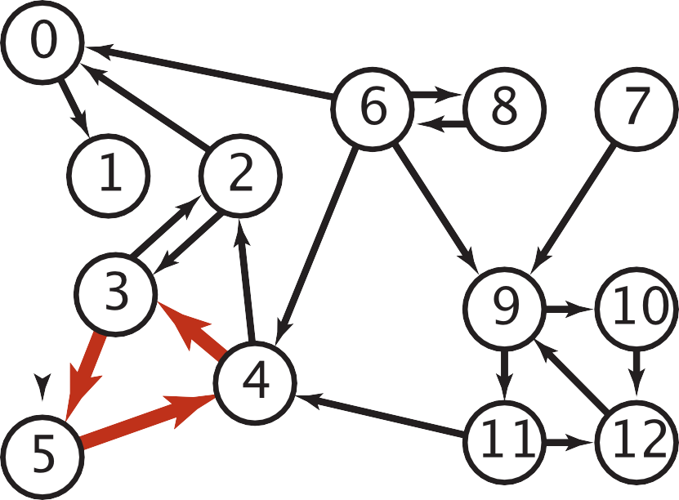

Cycles and Undirected Edges
Why is topological sort not possible for digraphs containing cycles?
Imagine a graph with 3 nodes and edges = {1 to 2 , 2 to 3, 3 to 1} forming a cycle. Now if we try to topologically sort this graph starting from any node, it will always create a contradiction to our definition. All the nodes in a cycle are indirectly dependent on each other hence topological sortfails
Why is topological sort not possible for graphs with undirected edges?
Special case of a cycle. An undirected edge between two nodes u and v means, there is an edge from u to v as well as from v to u. Because of this both the nodes u and v depend upon each other and none of them can appear before the other in the topological sort without creating a contradiction
a digraph with a directed cycle
A
C
B

Slide 26
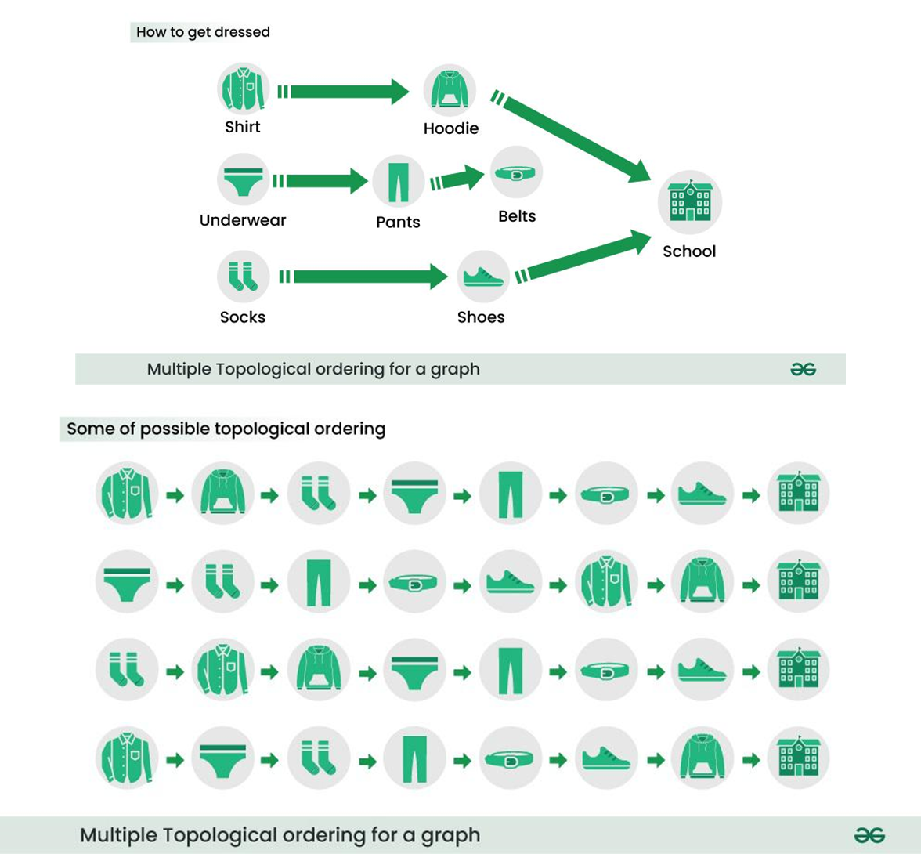
Topological Sort Example I

Slide 27
Topological Sort Example II
Give all possible topological orderings of this DAG
A
C
D
B
E
By observation, we can get (A, C, B, D, E), (A, C, B, E, D)
Notes:
More generally, if the only incoming edges are from nodes already in the ordering, it’s safe to add.

Slide 28
Topological Sort Example III
Give all possible topological orderings of this DAG
A
C
D
B
E
E
By observation, we can get: all possible interleavings with (AB) or (BA) before C, (DEF) or (DFE) or (EFD) after C. e.g., ABCDEF, BACEDF, etc.

Slide 29
DFS Traversals and Topological Sort
DFS pre-order traversal
Visit a node during DFS forward traversal before visiting all its unvisited neighbors
.Pre-order traversal is obtained in the order that nodes are pushed onto the stack, or when the recursive function call goes forward in the call stack
Upon finishing traversal starting from one node, restart from another unvisited node
DFS post-order traversal
Visit a node during DFS backtracking after visiting all its unvisited neighbors, i.e., after reaching a deadend.
Post-order traversal is obtained in the order that the nodes are popped off the stack, or when the recursive function call returns from the call stack
Upon finishing traversal starting from one node, restart from another unvisited node
Any post-order traversal of a graph must end with a node with incoming edges (no predecessors), hence any topological sort must start with a node with no predecessors
Tree traversal is a special case: any post-order traversal of a tree must end with the root
Topological sort:
Perform DFS post-order traversal starting from any node (often, but not necessarily, a node with no predecessors, to reduce the number of restarts) to get an ordered list of nodes, then reverse the node order to get a topological sort (one of multiple possible)
Intuition: DFS post-order traversal outputs nodes from the deepest (farthest away from the starting node) to the starting mode, hence the reverse order is a topological sort from the starting node
Notes:
when all its neighbors have been visited
Postorder. Add a vertex to a list after visiting all its outgoing neighbors.

Slide 30
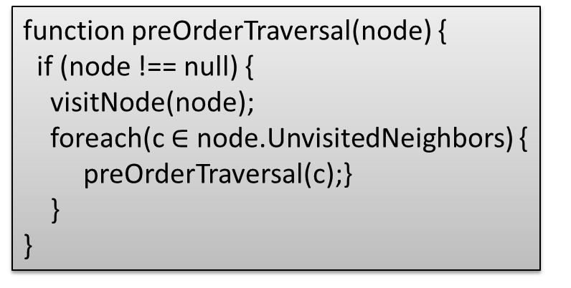
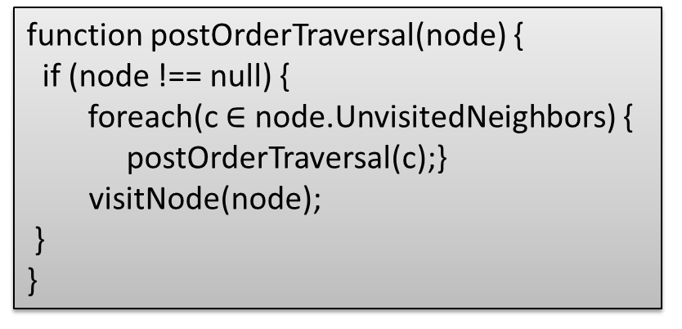
DFS Traversal of Graphs: Pre-order, Post-order
function preOrderTraversal(node) {
if (node !== null) {
visitNode(node);
preOrderTraversal(node.left);
preOrderTraversal(node.right);
}
}
function postOrderTraversal(node) {
if (node !== null) {
postOrderTraversal(node.left);
postOrderTraversal(node.right);
visitNode(node);
}
}
Recall: Binary Tree traversal with DFS: pre-order, post-order
function preOrderTraversal(node) {
if (node !== null) {
visitNode(node);
foreach(c $∈$ node.UnvisitedNeighbors) {
preOrderTraversal(c);}
}
}
function postOrderTraversal(node) {
if (node !== null) {
foreach(c $∈$ node.UnvisitedNeighbors) {
postOrderTraversal(c);}
visitNode(node);
}
}
The traversal algorithms works for both undirected and directed graphs. The only difference is how to get neighbors of node v, as each undirected edge is treated as two directed edges in both directions.
Notes:
(for post-order, visit a node during backtracking when all its neighbors have been visited)

Slide 31
Resolving Ambiguities
As There are typically multiple possible traversals of the same graph. In the lecture and exams, we often use the following rule to resolve any ambiguities:
“When there are multiple possible orders of visiting the next node, select the next node in alphabetical or numerical order.”

Slide 32
DFS Traversal Example I
Start from node 0
Visit nodes 0->1->4. Since 4 has no successors, backtrack to 0.
Pre-order: (0, 1, 4); post-order: (4, 1)
Visit node 2. Since 2 has no successors, backtrack to 0
Pre-order: (0, 1, 4, 2); post-order: (4, 1, 2)
Visit node 5. Since 5’s successor 2 has been visited, backtrack to 0. Since all of node 0’s successors have been visited, we visit it in post-order
Pre-order: (0, 1, 4, 2, 5); post-order: (4, 1, 2, 5, 0)
Restart from node 3, visit its successor 6, then backtrack. Since all of node 3’s successors have been visited, we visit it in post-order
Pre-order: (0, 1, 4, 2, 5, 3, 6); post-order: (4, 1, 2, 5, 0, 6, 3)
All nodes and their successors have been visited, so the algorithm terminates. A topological sort corresponding to this post-order is (3, 6, 0, 5, 2, 1, 4)
A BFS traversal: (0, 2, 5, 1, 4, 3, 6)
This is one of many possible traversals, e.g., if we start from node 3, then we have the traversals: pre-order: (3, 2, 4, 5, 6, 0, 1); post-order: (2, 4, 5, 1, 0, 6, 3); Topological sort: (3, 6, 0, 1, 5, 4, 2); BFS: (3, 2, 4, 5, 6, 0, 1)
0
0
2
5
1
3
4
6
Notes:
pre-order: (3, 5, 2, 4, 6, 0, 1); post-order: (2, 5, 4, 1, 0, 6, 3); Topological sort: (3, 6, 0, 1, 4, 5, 2); BFS: (3, 2, 5, 4, 6, 0, 1)

Slide 33
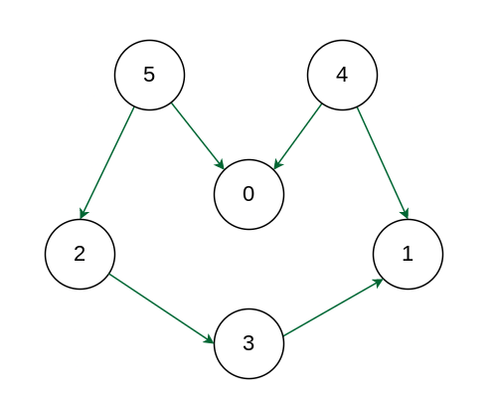
DFS Traversal Example II
Starting from node 5:
Pre-order traversal: (5, 2, 3, 1, 0, 4)
Post-order traversal: (1, 3, 2, 0, 5, 4)
Topological sort: (4, 5, 0, 2, 3, 1)
BFS traversal: (5, 0, 2, 3, 1, 4)
Starting from node 4:
Pre-order traversal: (4, 0, 1, 5, 2, 3)
Post-order traversal: (0, 1, 4, 3, 2, 5)
Topological sort: (5, 2, 3, 4, 1, 0)
BFS traversal: (4, 0, 1, 5, 2, 3)
Starting from node 0:
Pre-order traversal: (0, 5, 2, 3, 1, 4)
Post-order traversal: (0, 1, 3, 2, 5, 4)
Topological sort: (4, 5, 2, 3, 1, 0)
BFS traversal: (0, 5, 2, 3, 1, 4)
You may try starting from any other node.

Slide 34
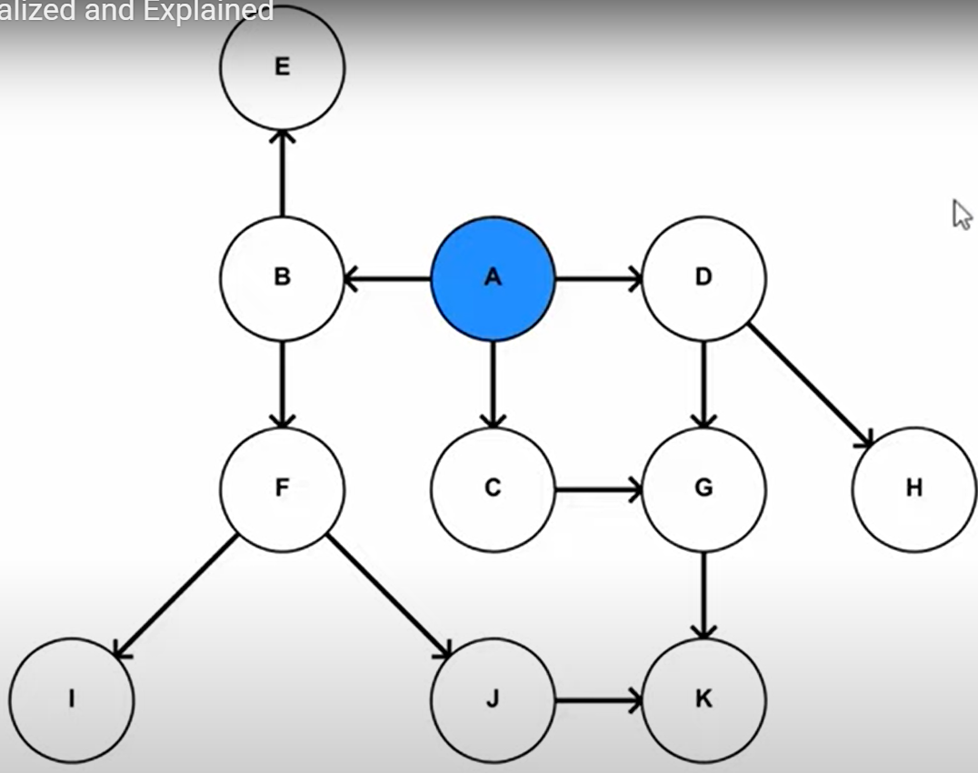
DFS Traversal Example III
Starting from node A:
Pre-order traversal: (A, B, F, I, J, K, E, C, G, D, H)
Post-order traversal: (I, K, J, F, E, B, G, C, H, D, A)
Topological sort: (A, D, H, C, G, B, E, F, J, K, I)
BFS traversal: (A, B, C, D, E, F, G, H, I, J, K)
Starting from a different node will give a different topological sort, but all of them must start with A, since it is the only node without any predecessors (i.e., it must precede all the other nodes based on the DAG)
Any post-order traversal must visit A last, since all of A’s sucessors must be visited before visiting A
Topological Sort Visualized and Explained
https://www.youtube.com/watch?v=7J3GadLzydI
Notes:
A topological sort is reverse order of Post-order traversal: “A D H C G B E F J K I”.

Slide 35
Kahn’s algorithm for Topological Sort
The algorithm works by repeatedly finding nodes with no incoming edges, removing them from the graph, and updating the incoming edges of the remaining nodes. This process continues until all nodes have been ordered.
Add all nodes with in-degree 0 to a queue.
While the queue is not empty:
Remove a node from the queue.
For each outgoing edge from the removed node, decrement the in-degree of the destination node by 1.
If the in-degree of a destination node becomes 0, add it to the queue.
If the queue is empty and there are still nodes in the graph, the graph contains a cycle and cannot be topologically sorted.
The nodes in the queue represent the topological sort of the graph.
Time Complexity: O(V+E).
The outer for loop will be executed V number of times and the inner for loop will be executed E number of times.

Slide 36
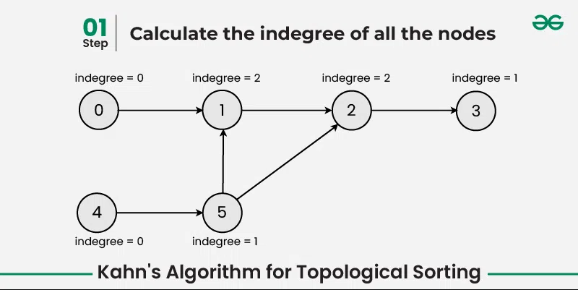
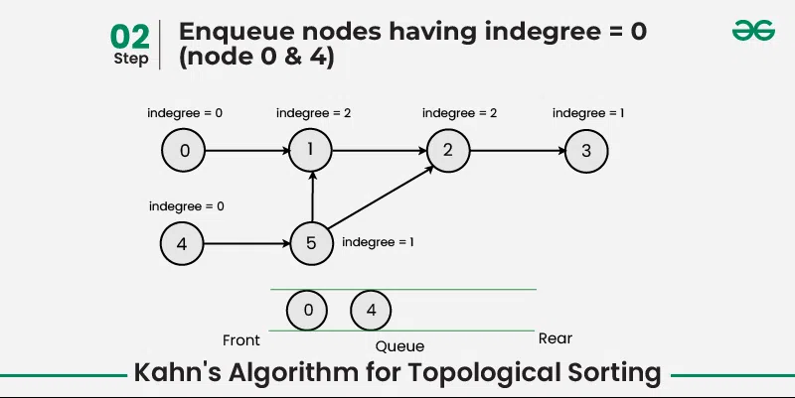
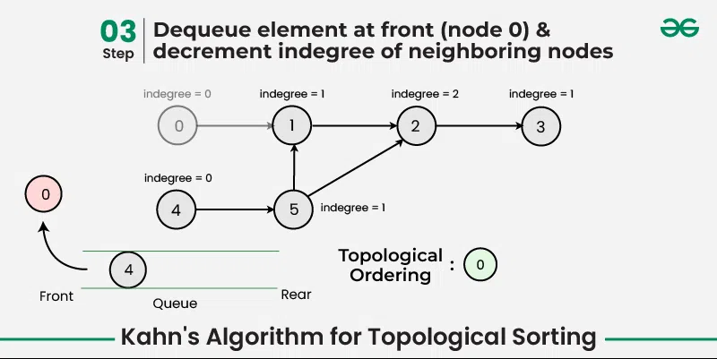
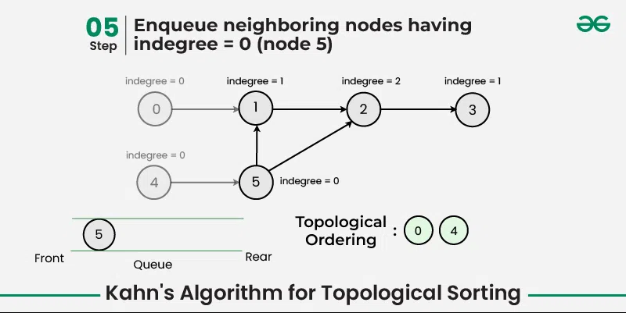
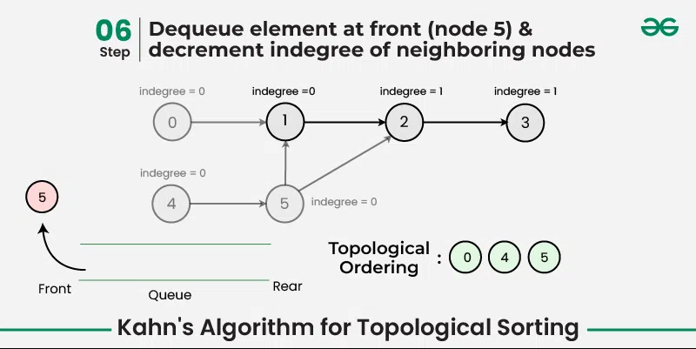
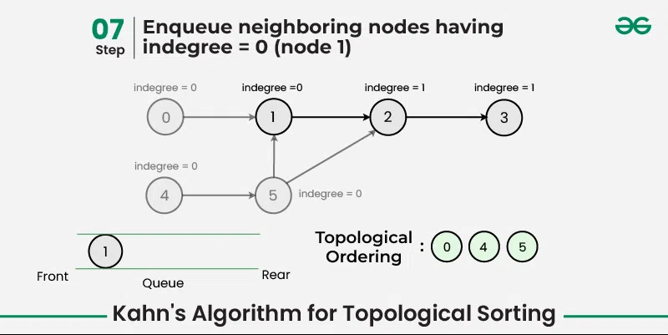

Slide 37
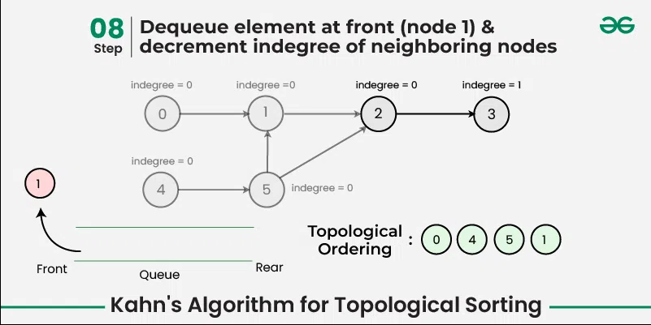
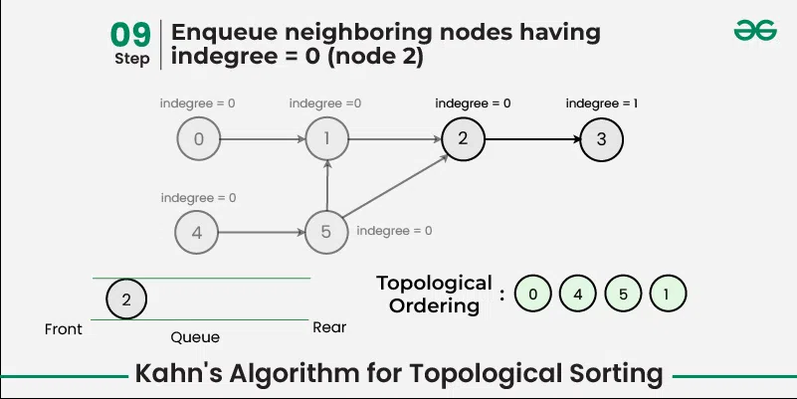
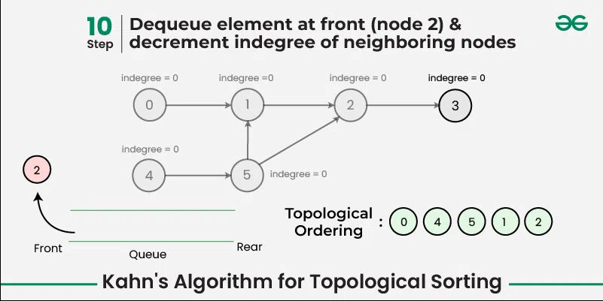
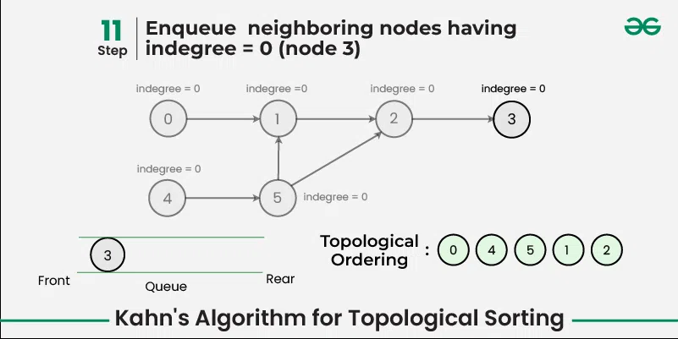
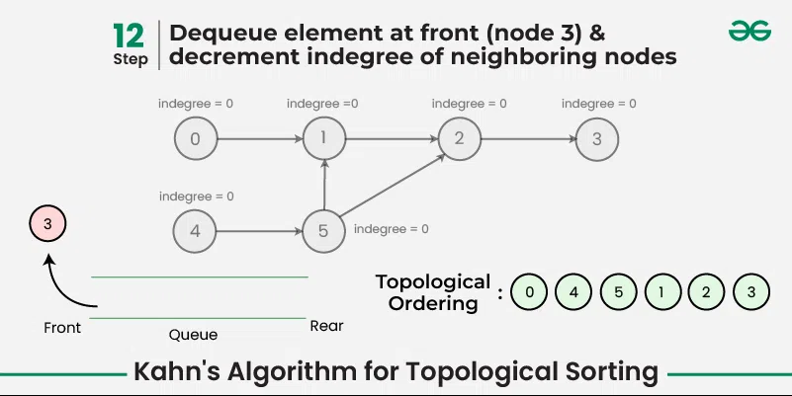
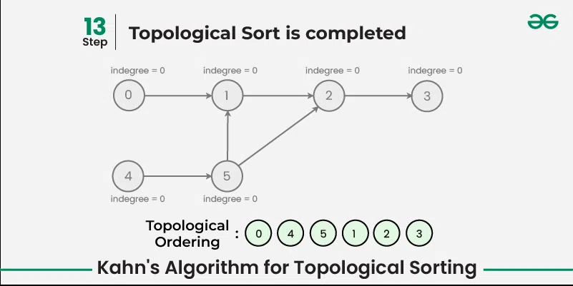

Slide 38
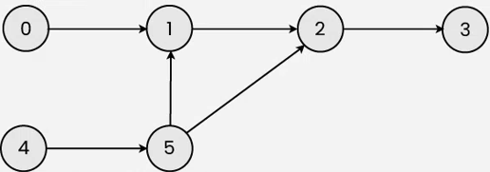
Graph Traversals
Give one DFS pre-order, in-order and post-order traversal of the following graph, and a topological sort.
Starting from node 4:
Pre-order traversal: (4, 5, 1, 2, 3, 0)
Post-order traversal: (3, 2, 1, 5, 4, 0)
Topological Sort: (0, 4, 5, 1, 2, 3)
BFS: (4, 5, 1, 2, 3, 0)
Starting from node 0:
Pre-order traversal: (0, 1, 2, 3, 4, 5)
Post-order traversal: (3, 2, 1, 0, 5, 4)
Topological Sort: (4, 5, 0, 1, 2, 3)
BFS: (0, 1, 2, 3, 4, 5)

Slide 39
References
Breadth-first search in 4 minutes (for a tree)
https://www.youtube.com/watch?v=HZ5YTanv5QE
Depth-first search in 4 minutes (for a tree)
https://www.youtube.com/watch?v=Urx87-NMm6c
Graph Traversals - Breadth First and Depth First (for an undirected graph)
https://www.youtube.com/watch?v=bIA8HEEUxZI
Breadth-First Search Visualized and Explained
https://www.youtube.com/watch?v=N6wicLpEmHY&list=PLnZHgAO8ocBv6XRqZkqQjrsIJijn82UUC&index=5
Depth-First Search Visualized and Explained
https://www.youtube.com/watch?v=5GcSvYDgiSo&list=PLnZHgAO8ocBv6XRqZkqQjrsIJijn82UUC&index=6
Topological Sort Visualized and Explained
https://www.youtube.com/watch?v=7J3GadLzydI&list=PLnZHgAO8ocBv6XRqZkqQjrsIJijn82UUC&index=7
Graph Algorithms, Programming and Math Tutorials (Playlist)
https://www.youtube.com/playlist?list=PLj8W7XIvO93oxLOZTi8JFghuRcKieIZU-
Notes:
5.1 Graph Traversals - BFS & DFS -Breadth First Search and Depth First Search, Abdul Bari
https://www.youtube.com/watch?v=pcKY4hjDrxk
Depth First Search Algorithm
https://www.youtube.com/watch?v=iaBEKo5sM7w
Breadth First Search Algorithm
https://www.youtube.com/watch?v=QRq6p9s8NVg

Slide 40
Full-Length Lectures
[CSE 373 WI24] Lecture 14: Graph Traversals
https://www.youtube.com/watch?v=1IJUv3ljqyU&list=PLEcoVsAaONjd5n69K84sSmAuvTrTQT_Nl&index=13

